Slide 1
VERSION CONTROL

Slide 2
BACKGROUND
Version control is an important part of software development to allow multiple people to work on the same project.
Without proper version control, projects could get overwritten on every new revision, and the work of multiple developers could get lost.

Slide 3
TECHNOLOGIES
Version Control:
GitLabs
GitHub
BitBucket
Version Visualization:
SourceTree
GitKraken
Git Graph

Slide 4
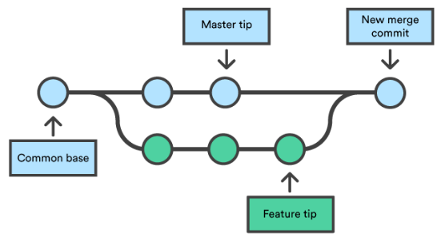
DEVELOP BRANCH
Checkout main branch (usually develop branch) and pull latest changes.
Create a new branch under a new name.
Develop required changes.
Merge and resolve conflicts branch into develop branch.
Regression test develop branch.

Slide 5
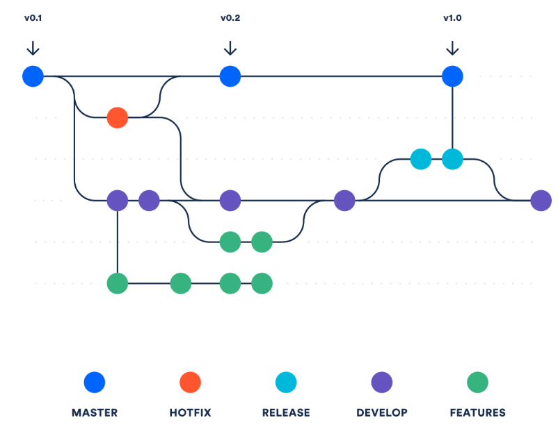
MASTER BRANCH
In production, there is usually not just a develop branch, but also a master branch.
The master branch gets released to production, and the develop branch gets merged to the master branch after regression testing is complete.
When a hot fix is required, it is merged on both the master branch and the develop branch because they are more time sensitive. It’s common to declare a ‘release captain’ during a hotfix, i.e. someone that manages the process from start to finish.

Slide 6
MERGE REVIEW
Before a merge is processed, a merge request aka pull request is made.
This is when a more senior engineer reviews the code and provides feedback before the merge can be processed.
When providing this feedback, it’s very important to stay as objective as possible, and avoid being subjective. Wasting back-and-forth development time for opinionated personal preferences has been the subject of many terminations and turnovers in the tech industry.
Many senior developers often lack the maturity and wisdom to stay objective on MR reviews.

Slide 7
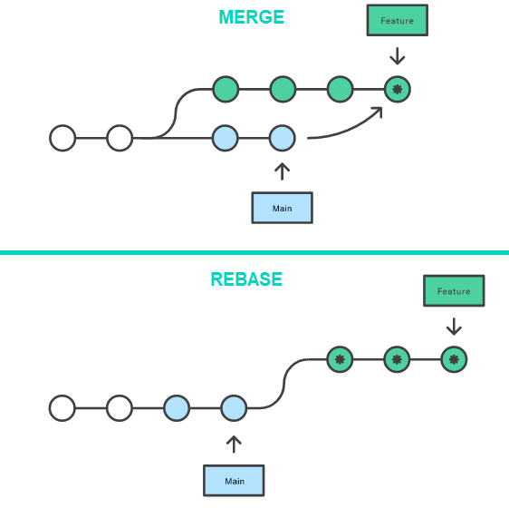
UPDATE BRANCH TO MASTER: MERGING VS REBASING
If you work at a company where the master is active, and your branch has become stale from working on it for weeks, it’s often required to update your branch to master.
To do this, you can either merge or rebase.
Merging transfers the changes of master into the latest commit of your branch.
Re-basing removes all the history from your branch, pulls the latest master, and pushes your latest commit on a new feature.
Depending on the workflow of your company, there are preferences for either methods.

Slide 8
GIT INSTALLATION
For any project you are working on, you can setup a git version control system.
All you have to do is install git on your computer and run git init.
A .git folder will be created in your project folder and you will be able to run git commands to create branches and merging changes. If you use VSCode you can even see a graph of your git branches by installing Git Graph as an extension.

Slide 9
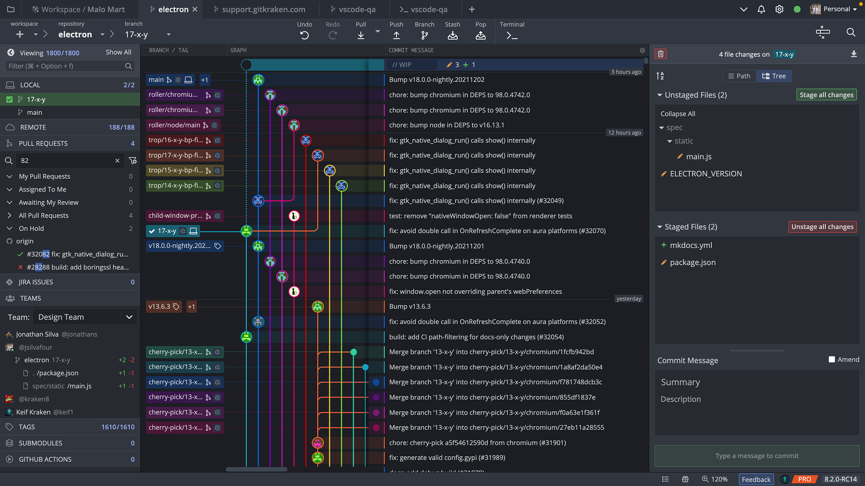

Slide 10
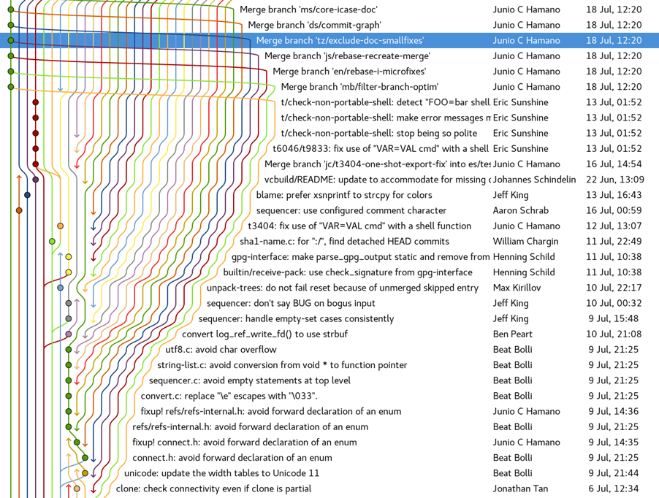

Slide 11
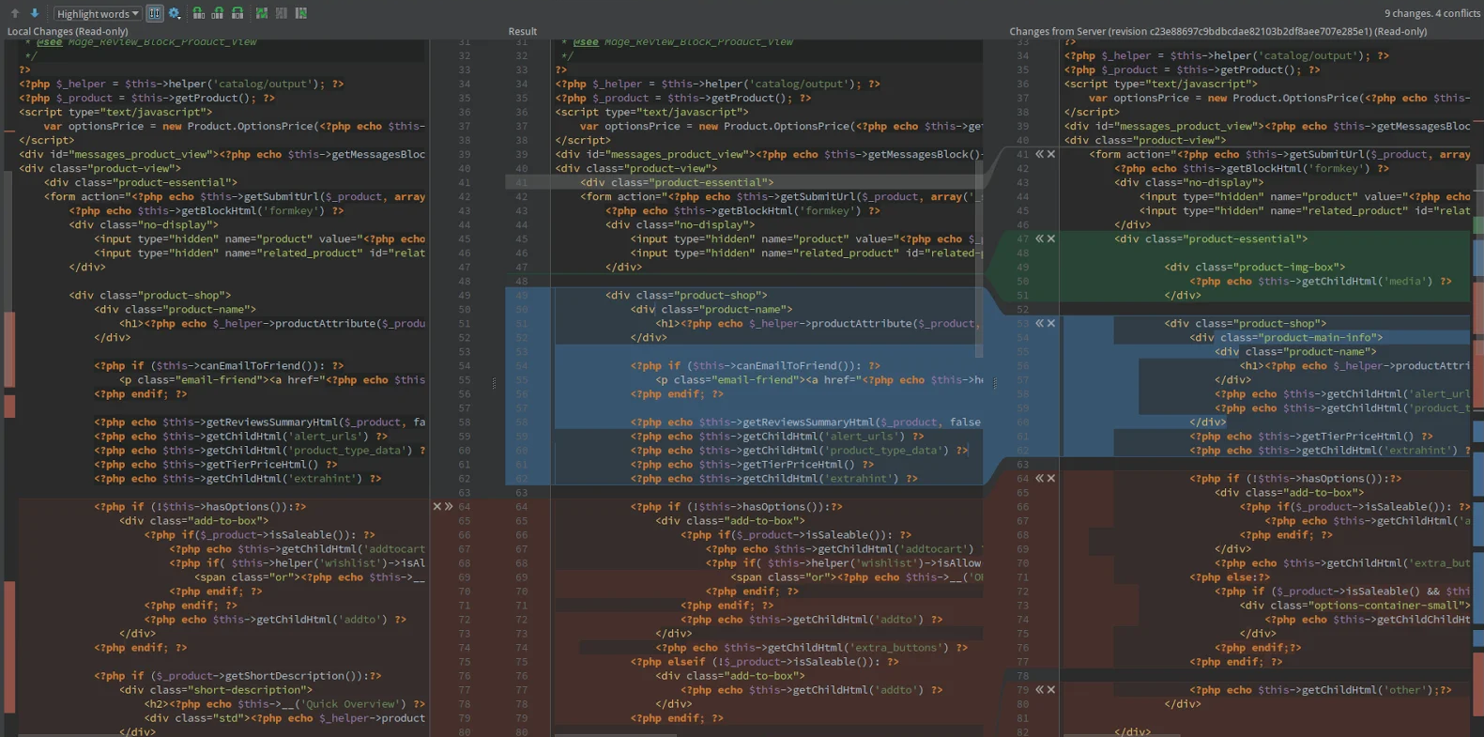
MERGE CONFLICTS

Slide 12


Slide 13
